Slide 1

The amazing world around us
I want to give you a presentation called ameizing world around us and I decided to present interesting facts about different dinosaurs

Slide 2
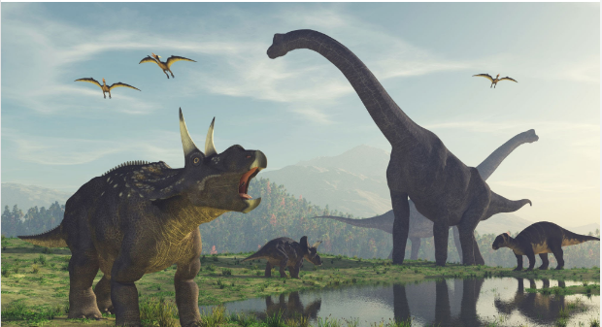
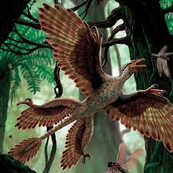
Microraptor
A crow-size creature uses sharp claws to scurry to the top of a hundred-foot-tall tree in what’s now northeastern China about 125 million years ago. Looking around for a snack, it spies a small flying critter. The dinosaur, called Microraptor, launches itself from the tree and glides down like a flying squirrel, catching the insect in its small teeth before gracefully landing on a lower branch. Crunch!

Slide 3
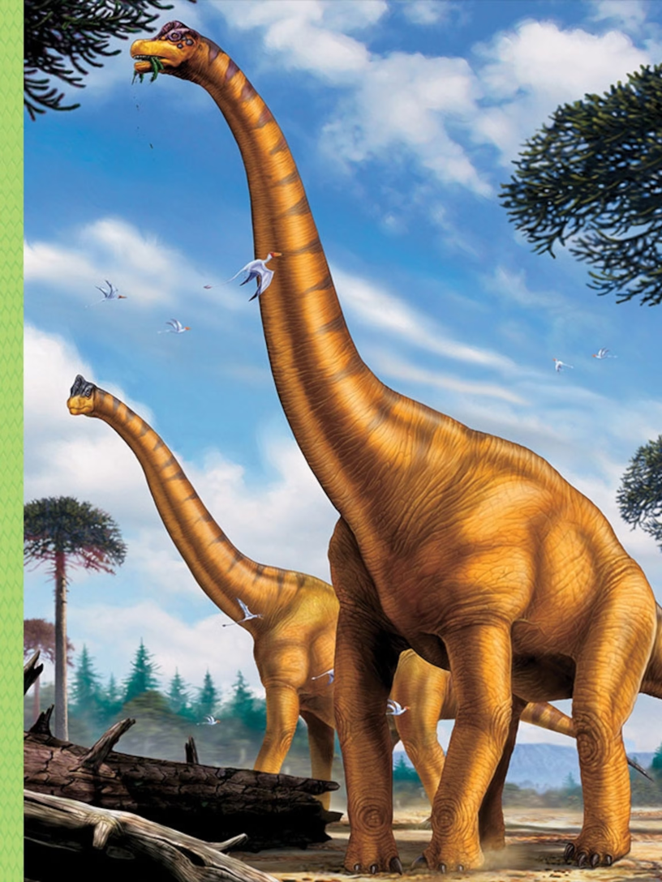
Brachiosaurus
A dinosaur the size of a four-story building slowly approaches a coniferous tree in what’s now North America. Stretching up its long neck, the creature rips off pine needles and leaves that few other dinos can reach. This huge plant-eater is Brachiosaurus, and it’s one of the biggest animals that’s ever walked the planet.

Slide 4
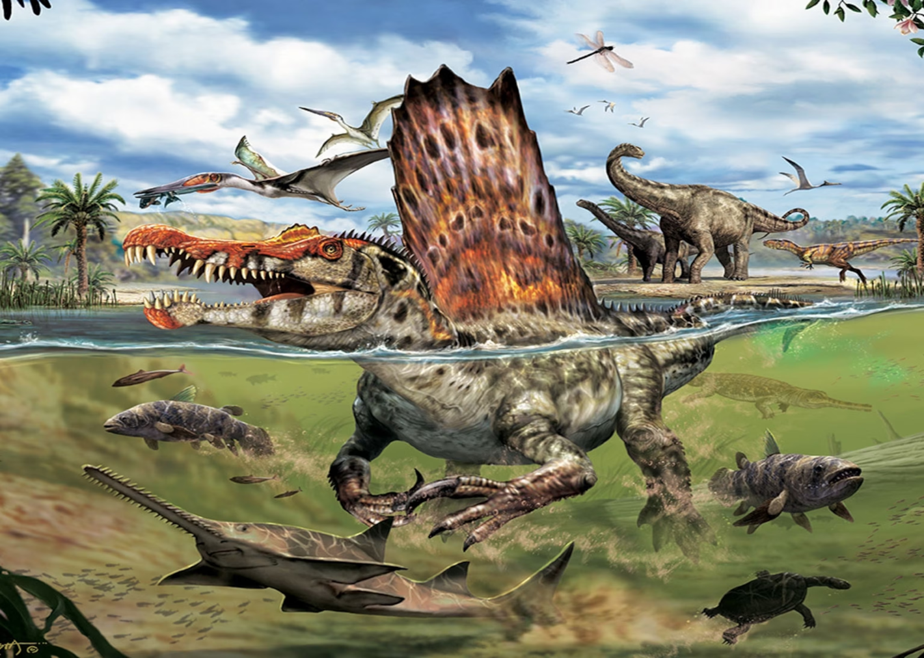
Spinosaurus
In a murky river that cuts through North Africa, a 50-foot-long hunter swims after a fish the size of a car. It sports six-inch-long teeth and a sail on its back with spines the size of surfboards. The hungry stalker closes in on the fish, gobbling up the meal. Then it glides away in search of more snacks. The creature isn’t some sort of enormous shark or a vicious crocodile. It’s a dinosaur called Spinosaurus, and it’s the only known dino that’s thought to have dwelled in water.

Slide 5
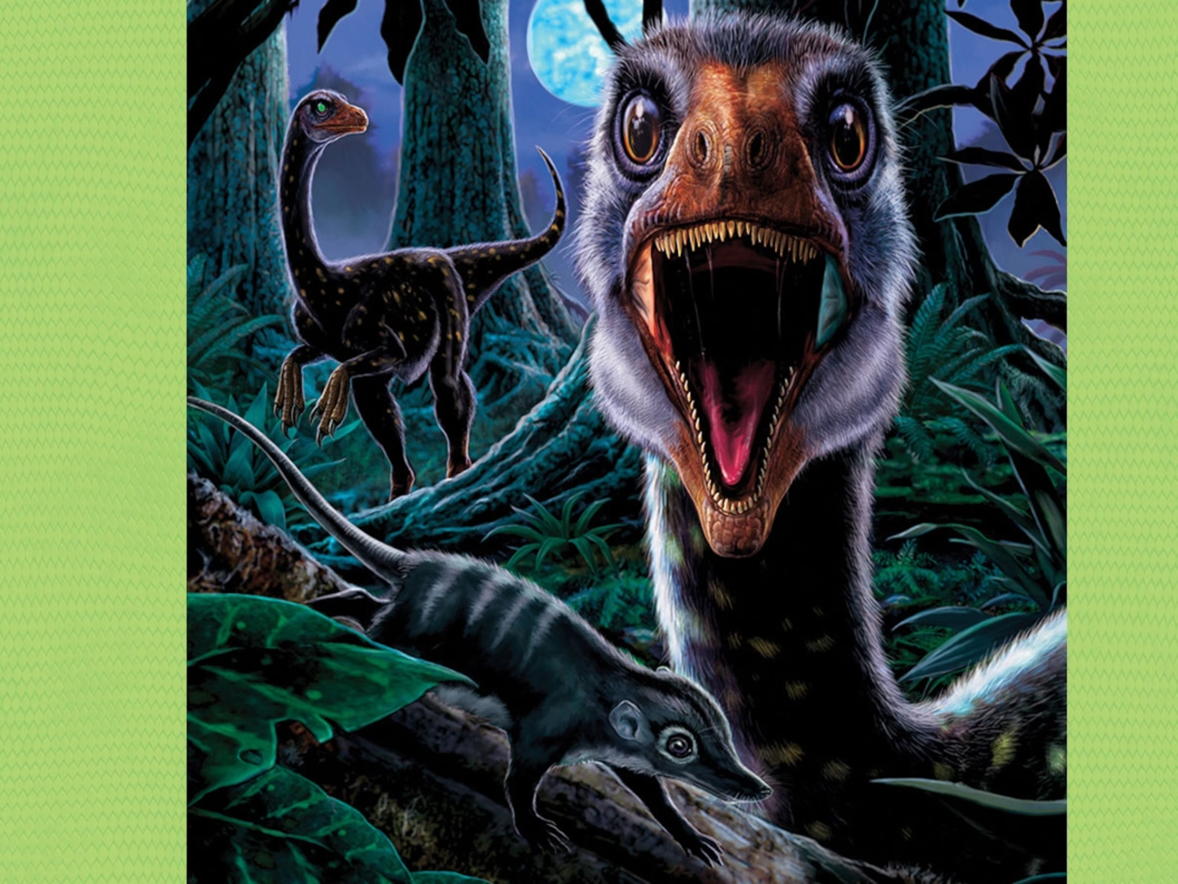
Troodon
Dashing through what’s now North America 76 million years ago, Troodon sniffs out dinner. Moving lightly on its two hind feet, the dinosaur follows its nose until it’s close enough to spot a mousey mammal. Using its strong eyesight, Troodon sneaks up on its prey, using its long arms and fingerlike claws to nab the critter.

Slide 6
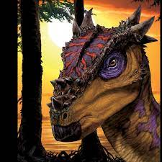
Dracorex
A group of paleontologists dust off three fossils that fit together to form part of a dinosaur skull in South Dakota in 2004. Could this be a never-before-discovered dinosaur? They take their find to the Children’s Museum of Indianapolis in Indiana to find out.

Slide 7
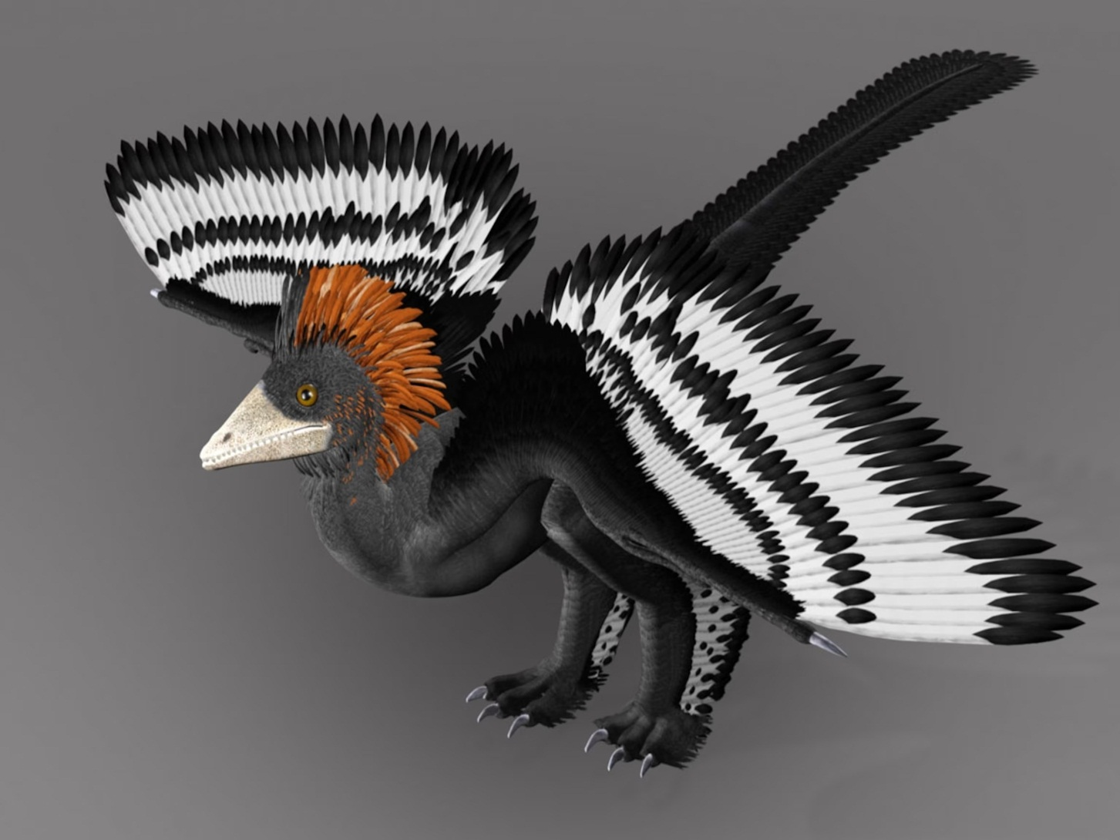
Anchiornis Huxleyi
A creature the size of a chicken sits on a tree branch in an ancient forest. It’s covered with feathers and has winglike limbs. Suddenly it spreads its limbs and glides down from its perch, landing on another branch. This animal is a bug-eating dinosaur called Anchiornis huxleyi, and it's the oldest soaring dinosaur that paleontologists have found so far.

Slide 8
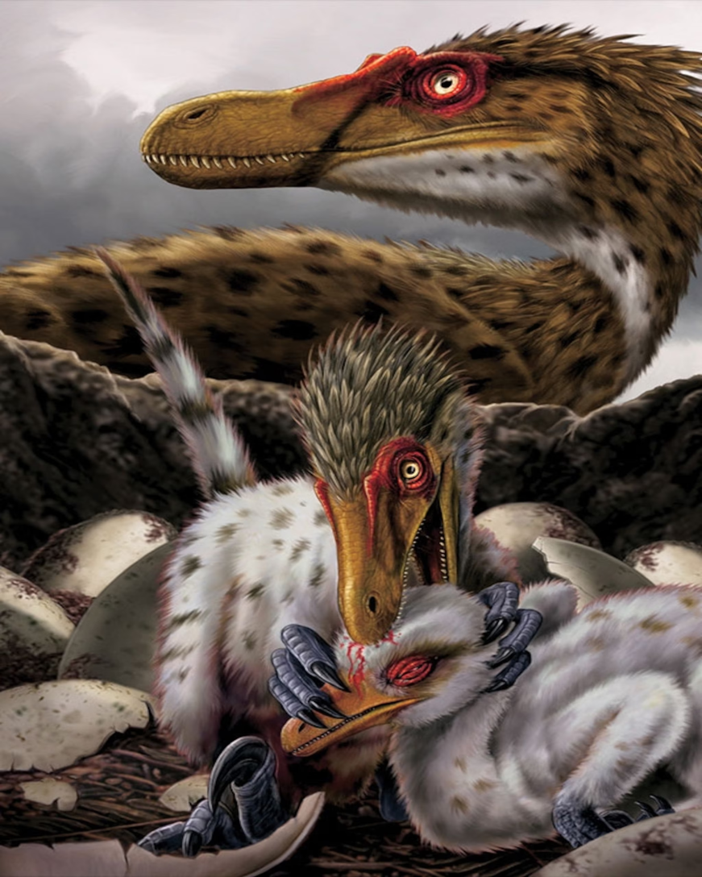
Velociraptor
A pack of two-legged creatures sprints across a desert about 70 million years ago. The dinos are each about six feet from the tip of their noses to the end of their long tails, but they’re only about as tall as a turkey. The group spots a Protoceraptops, an older cousin of Triceratops. Running 24 miles an hour, about as fast as a professional bicycle racer, the pack works together to chase the herbivore, jump on top of it, and grip the prey with two-inch-long claws. Then they feast using their 60 serrated teeth.

Slide 9
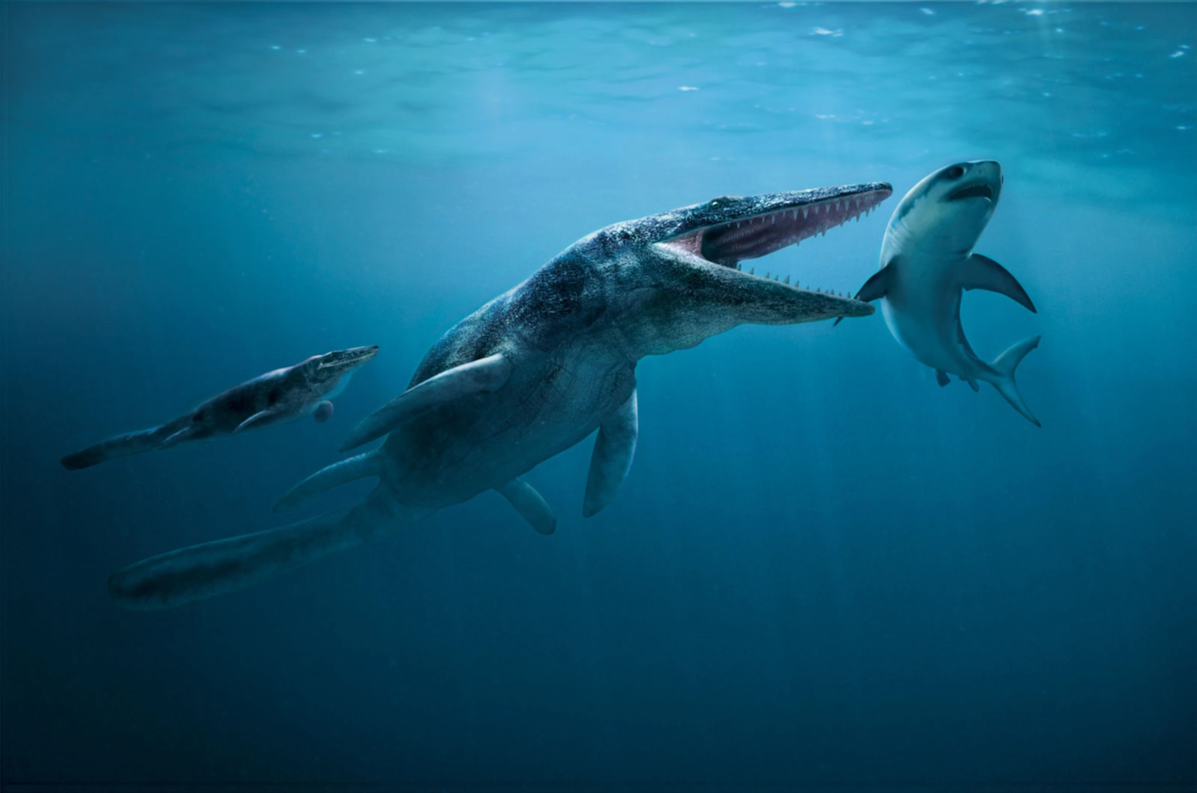
Tylosaurus Proriger
A prehistoric shark swishes through an ancient sea. The fish doesn’t know that it’s being watched from the dark depths below. Without warning, the shark is snatched by a set of massive jaws belonging to a 45-foot-long marine reptile. The lizardlike beast, known as Tylosauraus proriger, gulps down its snack, then sinks back into the darkness to stalk more unsuspecting prey.

Slide 10
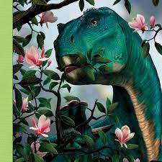
Iguanodon
An Iguanodon stands on its powerful hind legs and reaches for a flowering plant—something new on Earth at the time, around 130 million years ago. The dino uses its hands to pull the plant closer to its beak. Its mouth is full of curved and grooved teeth for grinding plants, and its jaws can move both up and down and side to side as it eats. The dinosaur takes a tasty bite.

Slide 11
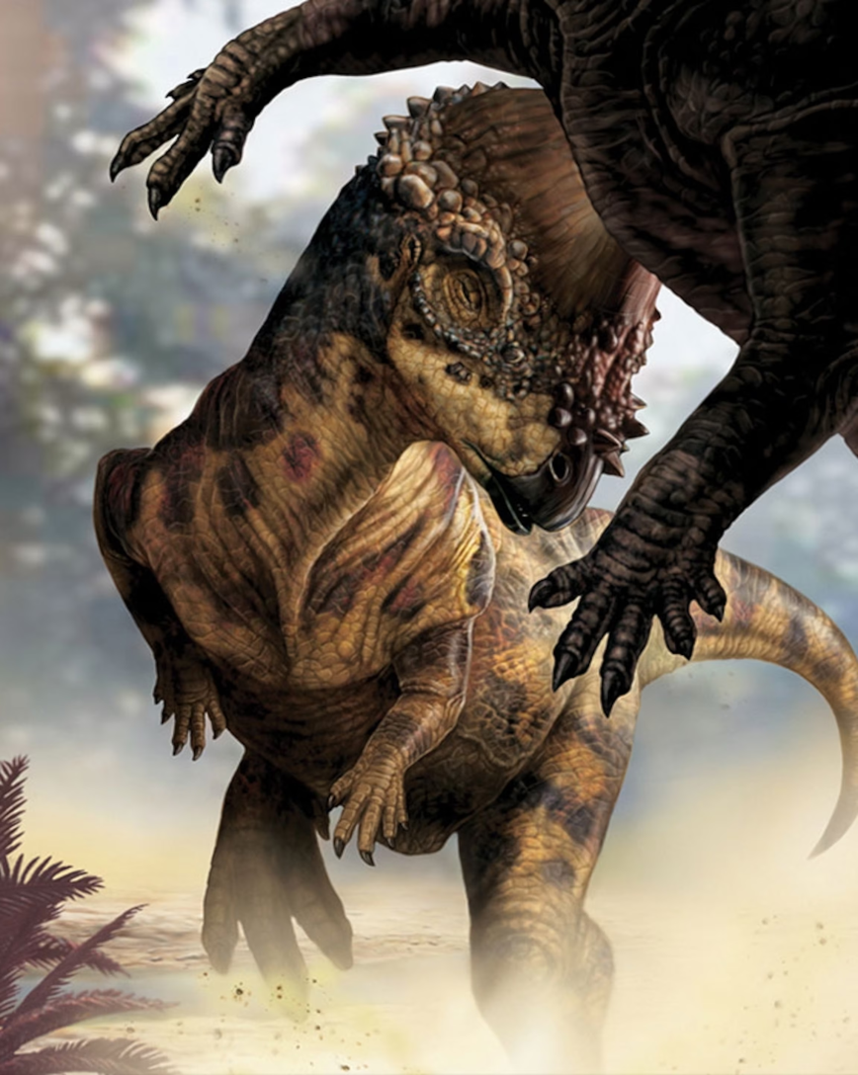
Pachycephalosaurus
A dino with a dome-shaped head grazes on ferns along a shoreline in what’s now Wyoming about 70 million years ago. Suddenly, another of its kind—called Pachycelphalosaurus—approaches, hungry for some greenery, too. The two aren’t willing to share, so they ram their nine-inch-thick skulls into each other’s bodies. Whichever dino backs down first will have to leave.

Slide 12
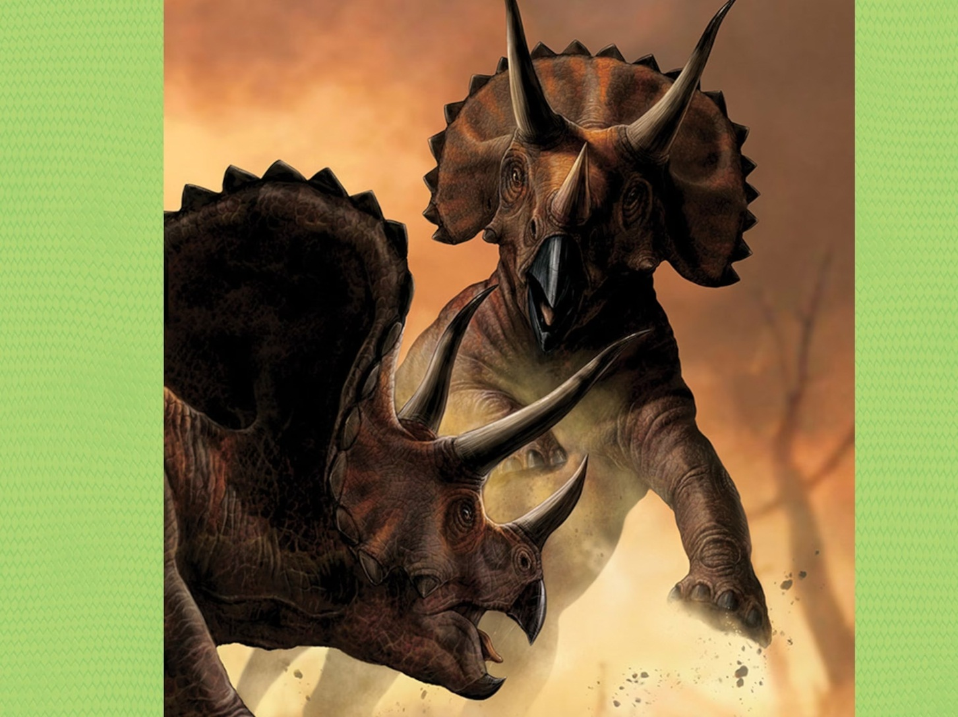
Triceratops
Two elephant-size dinosaurs face each other, showing off their long horns and bony neck frills. They’re both strong, fully grown Triceratops, and neither backs down. Suddenly, the two lurch forward and lock horns, pushing against each other like deer clashing antlers. One loses ground and walks away, defeated. The winner has impressed a nearby female Triceratops

Slide 13
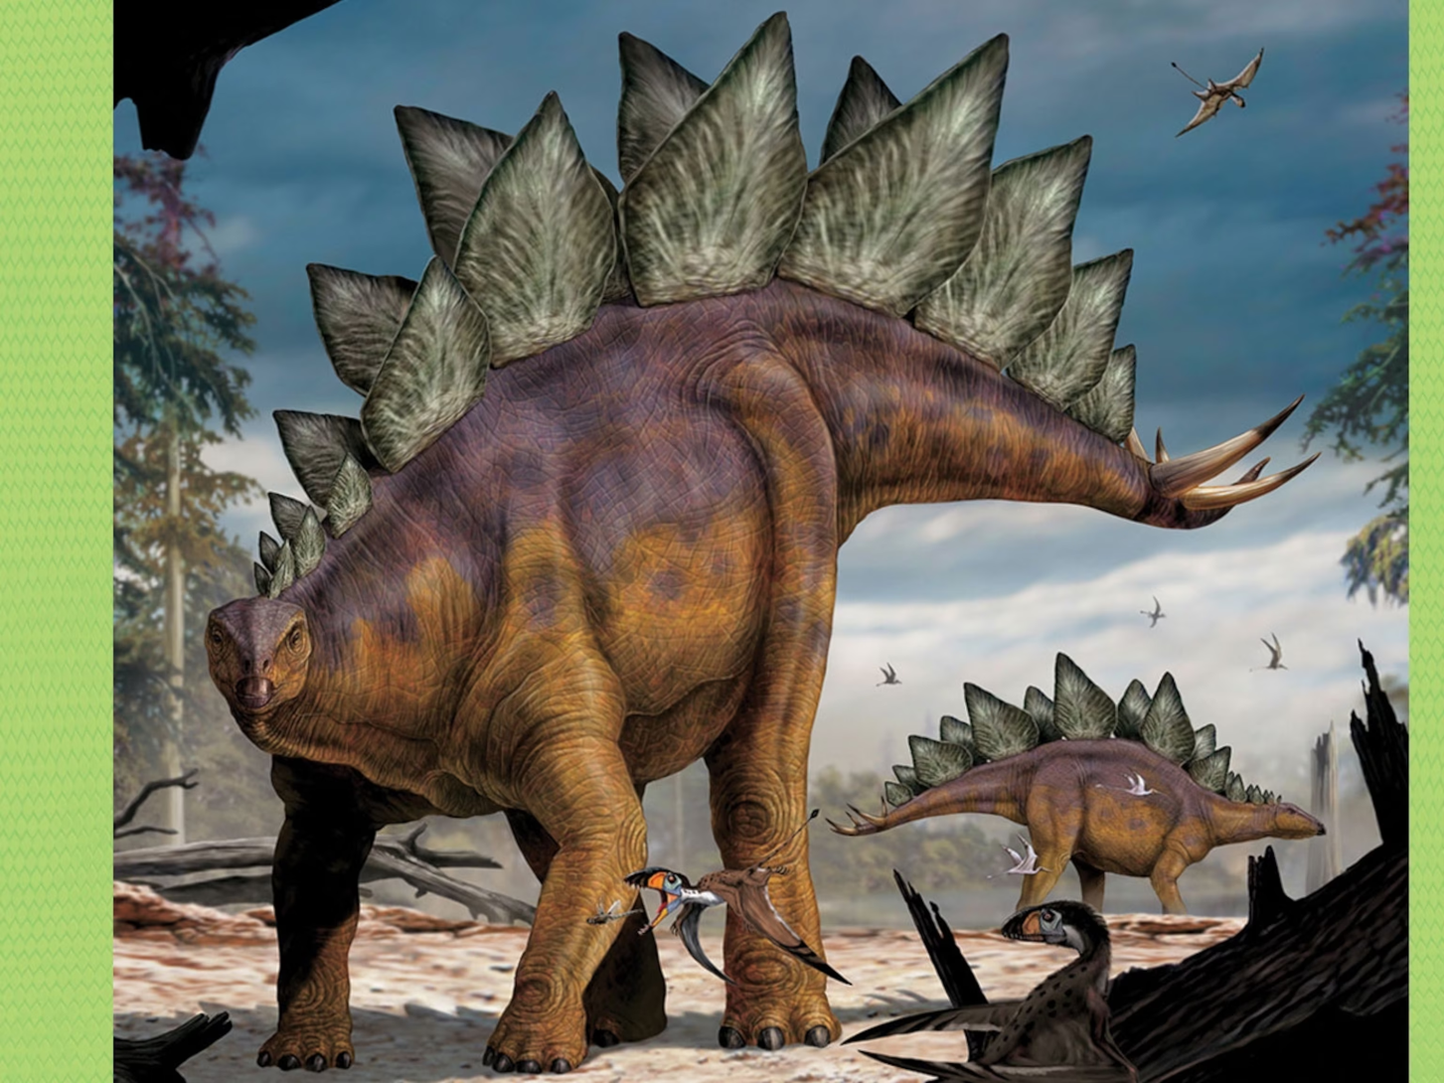
Stegosaurus
A hungry Allosaurus runs up to Stegosaurus, ready to attack. But as it gets close, Stegosaurus swings its heavy tail, and—whack! One of its thick, pointy spikes drives into Allosaurus’ tailbone. Allosaurus limps away, and Stegosaurus continues to munch ferns and young trees.

Slide 14
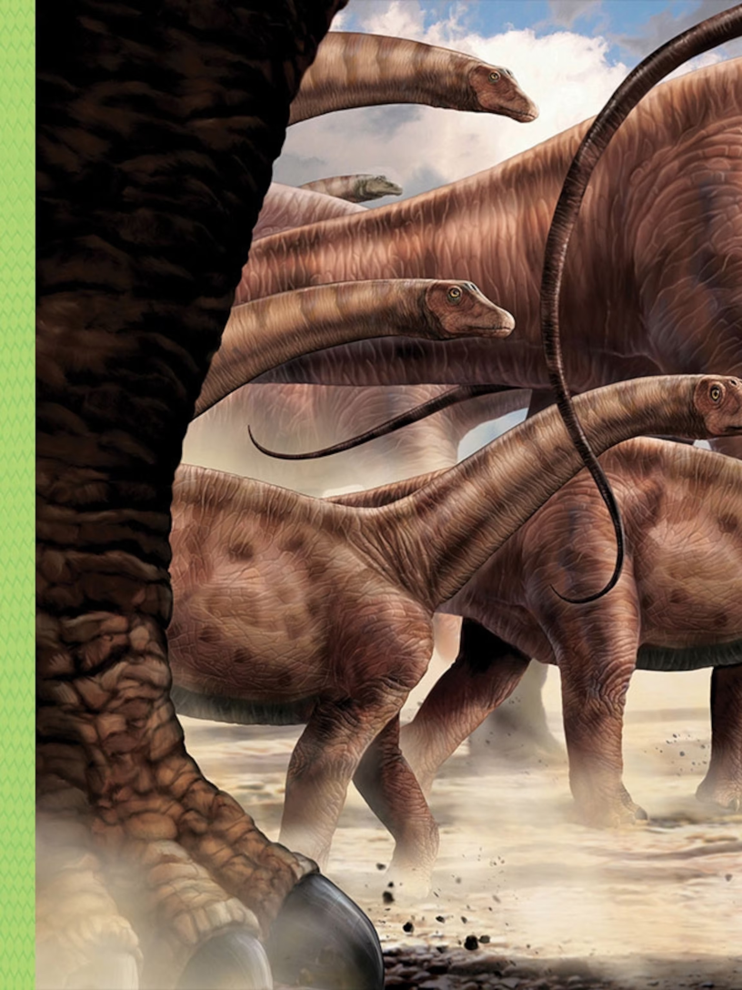
Apatosaurus
A herd of dinosaurs larger than highway trucks migrate across what’s now western North America. The group protects their babies from predators like Allosaurus by hiding the youngsters in the center of the herd. (And speaking of big babies: Apatosaurus eggs were about a foot long!) The 70-foot-long dinosaurs walk in search of tasty forest leaves.

Slide 15
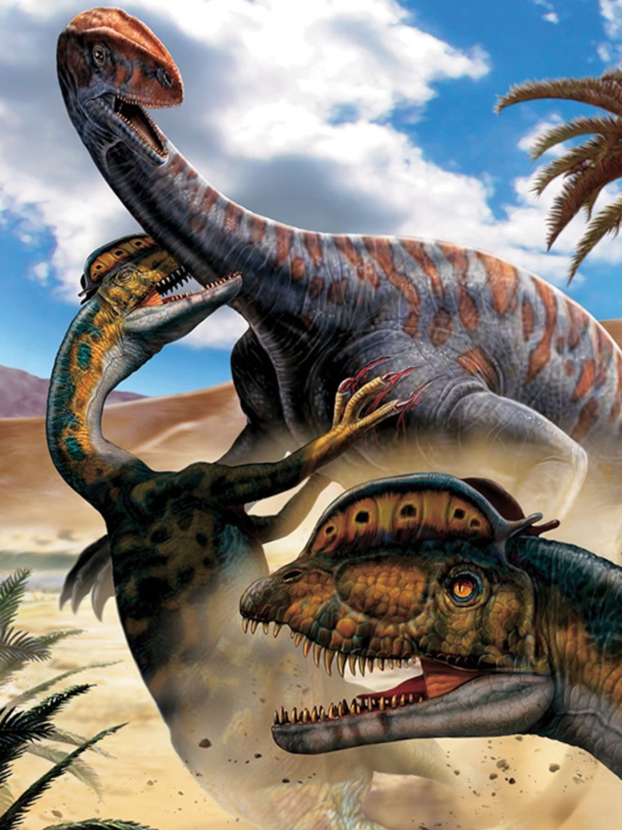
Dilophosaurus
Trotting on its hind legs through what’s now Arizona, a dino named Dilophosaurus searches for prey. Spotting an SUV-size herbivore in the distance, the 20-foot-long predator picks up its pace. Attacking the animal, it uses sharp claws and strong arms to hold its prey while it takes a bite.

Slide 16
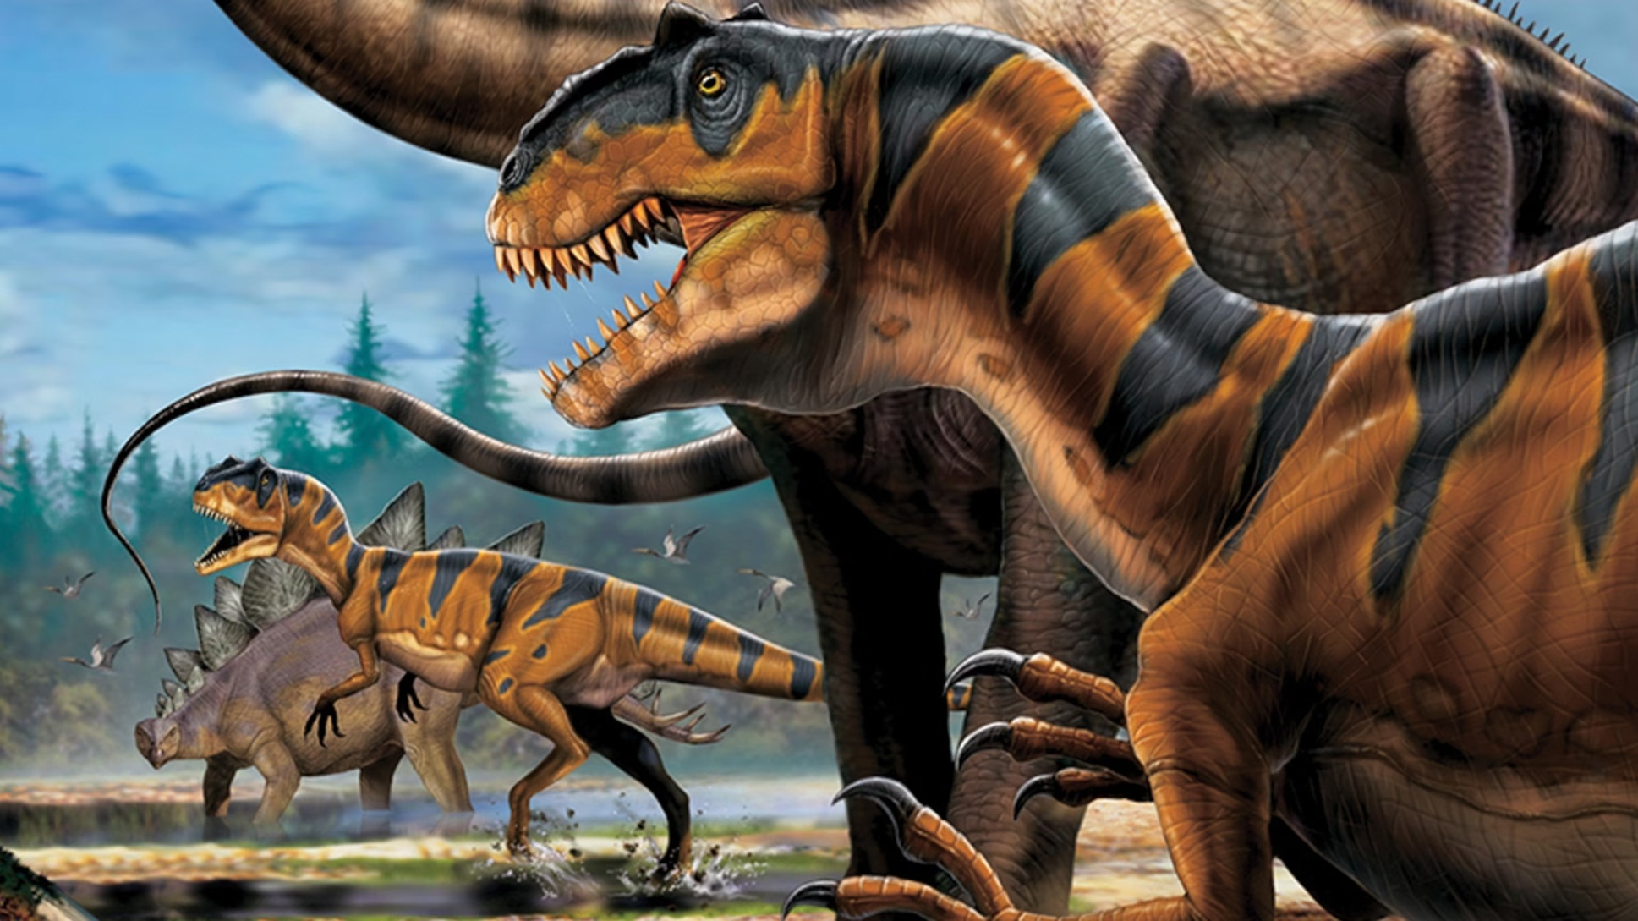
Allosaurus
An Allosaurus trots through the forest until it spies a young Stegosaurus—one of this dino’s favorite meals. Running on two feet, the carnivore sprints about 21 miles an hour, about as fast as a car driving through a neighborhood. With eight-inch-long claws, it grabs Stegosaurus and chomps down with 70 sharp, thick teeth. Lunch is served.

