Slide 1
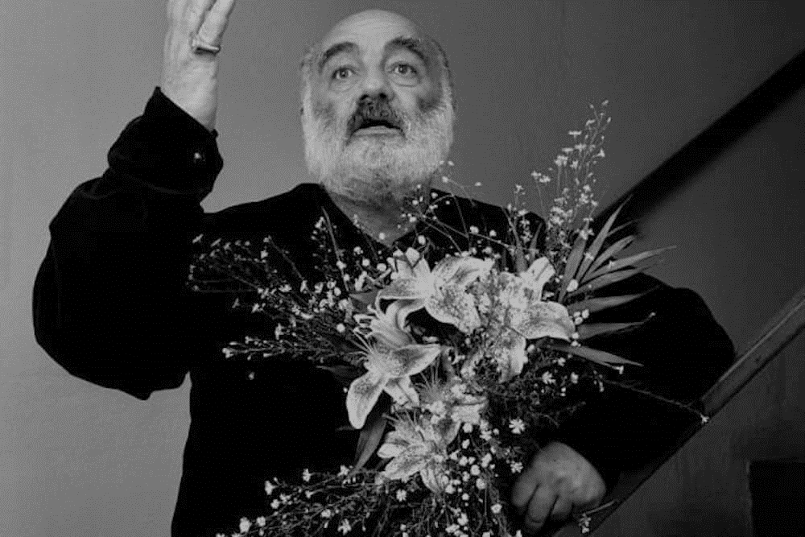
Sergei Parajanov

Slide 2
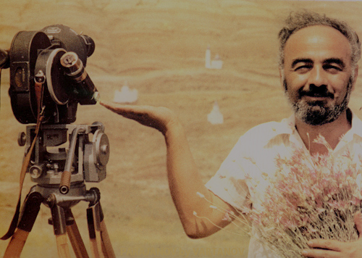
Sergei Parajanov (1924–1990) was a world-renowned Armenian film director and artist, celebrated for his unique and visionary approach to cinema. Parajanov is considered one of the most influential filmmakers in the history of cinema, known for his poetic and surreal style, which broke traditional cinematic forms.

Slide 3
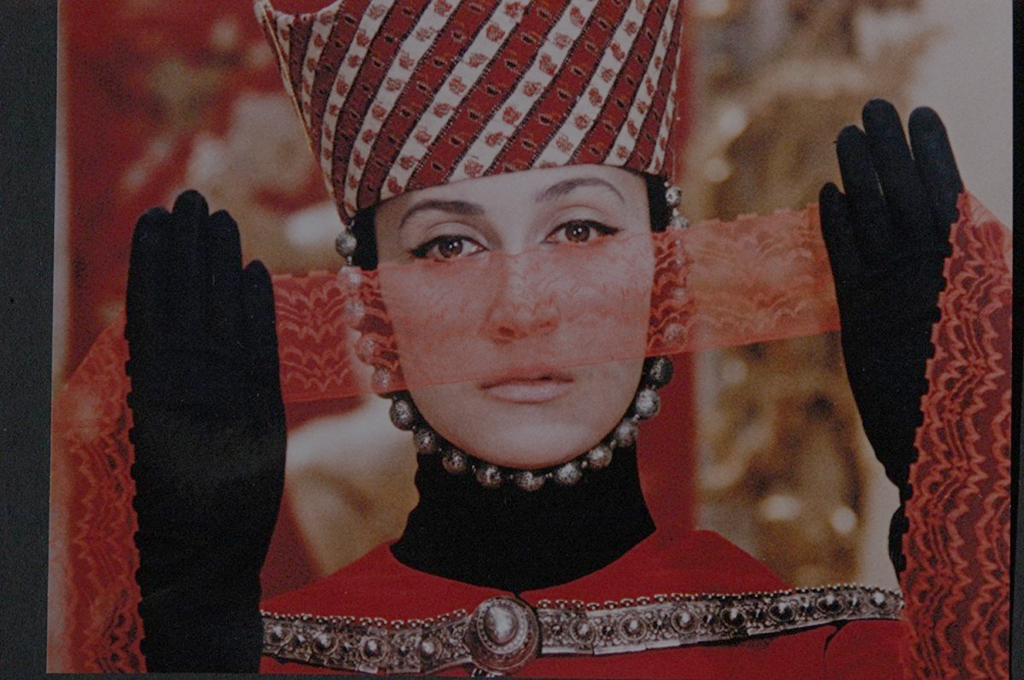
Directing and Filmmaking – Parajanov created iconic films such as Shadows of Forgotten Ancestors (1965), The Color of Pomegranates (1969), and The Legend of Suram Fortress (1985), using his distinct visual style that combined symbolism, folklore, and surrealism

Slide 4
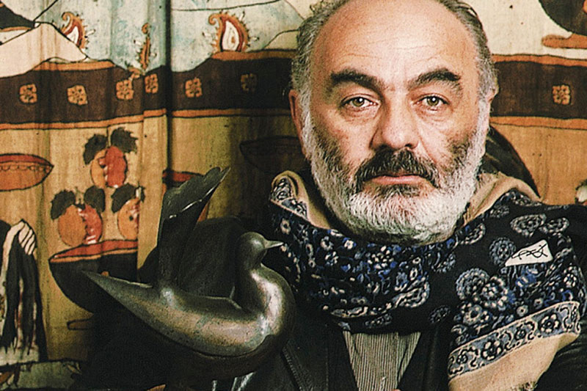
Artistic Expression – Beyond filmmaking, Parajanov was also an artist, creating visual works that reflected his innovative approach to storytelling and his deep connection to cultural traditions.

Slide 5
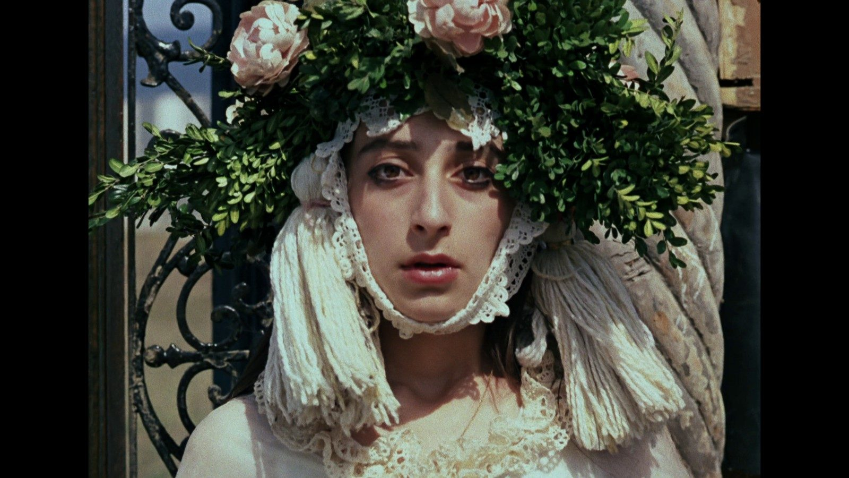
Cultural Preservation – His films often explored and preserved the folklore, traditions, and history of Armenia, Georgia, and the broader Caucasus region.
Challenging Soviet Authorities – Parajanov’s films and his outspoken personality led to conflict with Soviet authorities, resulting in his imprisonment and censorship, which marked a significant part of his life and career.

Slide 6
His artistic activities were revolutionary, blending cinema with visual art in ways that challenged conventional filmmaking techniques and established him as a major figure in world cinema.

